Slide 1


A Project on VIRTUAL ASSISTANT FOR COLLEGE
Under the Guidance
of
Prof. Seema. Mahalungkar
1) Amey Sameer Alate-A-2064191242007
2) Lakshay Khokhar-A-2064191242032
3) Rohit Rajendra Barate-A-2064191242054
4) Rushikesh Jagdevrao Bhumkar-A-2064191242057

Slide 2
Contents
Project Domain and Title
Introduction
Literature Survey
Motivation
Problem Statement
Methodology [and Dataset if applicable]
System Architecture & Requirement Specification
Conclusion
References

Slide 3
Project Domain and Title
Project Domain : NLP and ML
Title : Virtual Assistant For Our Institue NCER (Student Assistant Chatbot)

Slide 4
Nutan College of Engineering and Research Student Assistant Chatbot
This presentation provides an overview of the development and implementation of a student assistant chatbot for admission-related queries and general enquiries at Nutan College of Engineering and Research (NCER). The presentation introduces the need for the chatbot and discusses the objectives, data collection, query handling, dataset preprocessing, model approach, image processing, language chain framework, hosting solutions, and precautions and future enhancements. The presentation includes real-world or 3D images to enhance understanding of the content.

Slide 5
Introduction
This presentation is about Nutan College of Engineering and Research's student assistant chatbot. The chatbot is the solution to the increasing need for an efficient and effective way to assist students with their queries regarding academics, events, and other activities related to the college. The presentation begins with a brief overview of NCER and its various departments before delving into the need for the chatbot.

Slide 6
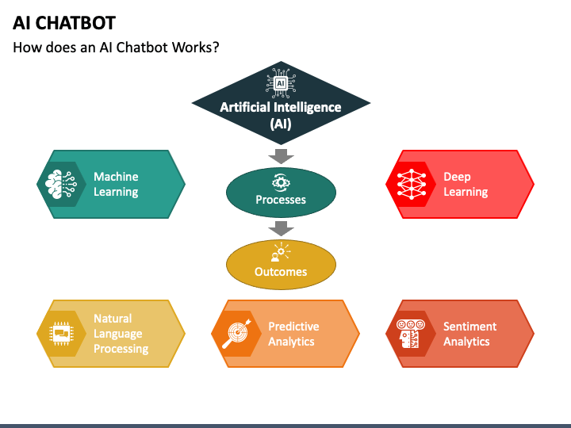
Overview of the Presentation
The presentation discusses the student assistant chatbot at Nutan College of Engineering and Research.
It explains the importance and need for the chatbot and how it can help students.
The presentation provides an overview of NCER, its various departments, and how the chatbot caters to the needs of students.

Slide 7

Literature survey
Sr NO | Paper Name , Year | Author Name | Methodology/ Algorithms/ Techniques/ | Datasets | Accuracy/ Results | Advantage | Disadvantage | Future scope
1 | Artificial Intelligence Enabled Mobile Chatbot Psychologist using AIML and Cognitive Behavioral Therapy (2023) | Batyrkhan Omarov , Zhandos Zhumanov , Aidana Gumar , Leilya Kuntunova | Deep learning algorithm | Dataset of depressive posts (in Russian Language) | 92% | users can use the proposed chatbot to improve their knowledge | users can use the proposed chatbot to improve their knowledge | potential enhancements to the AI-enabled mobile chatbot
2 | A Chatbot Application by using Natural Language Processing and Artificial Intelligence Markup Language (2022) | Vanshika Arya, Rukhsar Khan, Mukul Aggarwal | emphasizing "cognition capabilities" for understanding user input and user engagement | Create dataset for different queries which are analyzed with NPL | 93% | using AIML in our chatbot is that it becomes very simple to apply and learn | lack natural language processing capabilities and cannot understand context | Improving in customer service and user experience

Slide 8
Sr NO | Paper Name , Year | Author Name | Methodology/ Algorithms/ Techniques/ | Datasets | Accuracy/ Results | Advantage | Disadvantage | Future scope
3 | Building a Chatbot for Supporting the Admission of Universities (2021) | Minh-Tien Nguyen , Manh Tran-Tien , Anh Phan Viet , Huy-The Vu , and Van-Hau Nguyen | Keyword matching, String similarity and Combination of algorithms | Vietnamese dataset, including questions and answers | 89% | Time saving, Consistent information, Cost-effective, Data collection | Generating conversation is challenging for the bot | Like to improve the quality of NLU and dialog management to generate more correct answers.
4 | The Use of Chatbots in Digital Business Transformation: A Systematic Literature Review (2021) | ANDREJ MIKLOSIK , NINA EVANS, ATHAR QURESHI | Methods employed in the sample of papers include experiments, questionnaire, prototyping. | The Web of Science database was selected as the source of papers for this SLR | Improving chatbot development with smaller datasets and enhancing human-likeness | Improving customers' experience and reducing costs. |  | Guiding in research methods, publication choice, and spotting influential studies with high Altmetric Attention Scores.
5 | Natural language processing and deep learning chatbot using long short term memory algorithm (2021) | E. Kasthuri, S. Balaji | Long short term memory algorithm | Hospitals dataset to help the customers freely ask medical dosage-associated queries with the aid of voice. | 91% | Can answer complex-level queries | Take longer to train, require more memory and are easy to overfit. | A voice-based system is included, and using Tkinter GUI has developed the chatbot for better use

Slide 9
Sr NO | Paper Name , Year | Author Name | Methodology/ Algorithms/ Techniques/ | Datasets | Accuracy | Advantage | Disadvantage | Future scope
6 | An Intelligent Web App Chatbot (2020) | SHAZIYA BANU, SHANTALA DEVI PATIL | Linguistic machine learning algorithm | datasets from cancer forums | 95% | Helps in candidates interviewing during placement and reduces time | Recognizing user intent, User Language, Limitations of NLP | Adding the NLP for predicting the user query and enabling the speech recognition for the bot.
7 | Dexter the College FAQ Chatbot (2020) | Ajinkya Huddar , Chaitanya Bysani , Chintan Suchak , Uttam D Kolekar , Kaushiki Upadhyaya | Pattern matching, K- nearest neighbour algorithm | Predefined dataset (partially trained) and provide answers from database |  | Easier way to solve their queries faster and reduce the work stress of the receptionist | Needs Analyzing, Higher Misunderstanding,Less Understanding of Natural Language | Train the dataset and database according to future uses
8 | Enhancing College Chat Bot Assistant with the Help of Richer Human Computer Interaction and Speech Recognition (2020) | Sangeeta Kumari , Zaid Naikwadi, Akshay Akole, Purushottam Darshankar | It is a interactive agent software which interacts with human via textual or auditory methods |  |  | Simplifying the admission process, providing detailed information, handling various types of queries, allowing user feedback |  | Enhancing chatbot understanding and language processing, achieving Turing test-level performance, improving accuracy in recognizing queries

Slide 10
Sr NO | Paper Name , Year | Author Name | Methodology/ Algorithms/ Techniques/ | Datasets | Accuracy | Advantage | Disadvantage | Future scope
9 | Interactive Transport Enquiry with AI Chatbot (2020) | Dharani M, Jyostna JVSL, Sucharitha E, Likitha R | Recurrent Neural Network algorithm | Bus dataset is taken from city buses database | 95% | conducting a thorough literature review for task coherence, and leveraging advanced technologies and algorithms for an efficient chatbot. | Limited Understanding, Reduced Human Interaction, Maintenance and Updates | Enlarging it to web support, providing voice chat, Initiate database and perpetuate users
10 | Review on Implementation Techniques of Chatbot (2020) | Nithuna S, Laseena C.A | Natural language processing, simple ML algorithms | Organizational database |  | Improved customer interaction, increase flexibility through AIML-based chatbots, cost-effectiveness compared to human agents
11 | Survey of Textbased Chatbot in Perspective of Recent Technologies (2019) | Bhriguraj Borah, Dhrubajyoti Pathak, Priyankoo Sarmah, Bidisha Som, Sukumar Nandi | Pattern matching, AIML, NLU, NLP | Large amount of interaction data |  | Computationally intelligent chatbot, exploring supervised learning for intelligence, and leveraging recent developments in NLP, NLU, ML | Not appropriate for complex conversation bots. Very less NLP and ML specific components | The chatbot keeps a record of its interactions for future learning and self-improvement.
12 | Enterprise Chat Platform using Machine Learning Techniques (2019) | Malvika R, Vikram K Kharvi, Akhil Bidhuri, Bhaskar Kumar, Dr Annapurna D | CNN, RNN , Naïve Bayes, SVM | Twitter dataset | 80% | Deploying an Enterprise Chat Platform with machine learning for instant sentiment analysis and concise message summaries, enhancing communication and management. | Challenges with identifying sentiment in sarcasm and the intricacies of text summarization for platform use. | Experimenting with hybrid models and advanced networks for sentiment analysis, and enhancing text summarization

Slide 11
Sr NO | Paper Name , Year | Author Name | Methodology/ Algorithms/ Techniques/ | Datasets | Accuracy | Advantage | Disadvantage | Future scope
13 | Knowledge Based CHATBOT With Context Recognition (2019) | Rico Arisandy Wijaya, Entin Martiana Kusumaningtyas, Aliridho Barakbah | Text Mining Method | Mining of Massive Dataset | 87% | Enhanced chatbot accuracy through synonyms, pre-processing, and binary cosine similarity, potentially increasing accuracy by 25%. | time-consuming process of creating and updating synonym dictionaries, the potential for errors when adding synonyms | further improvements in synonym handling, developing efficient synonym dictionary creation methods
14 | Various Real Time Chat Bots and Their Applications in Human Life (2019) | V. Krishna sree, C. Kaushik, G. Sahitya, Remalli Rohan | K-NN classification algorithm, AGNES algorithm | College based dataset for all queries | 85% | General purpose chatbots must be user friendly, easy to understand and be simple |  | Improving performance with artificial neural networks, enhancing their use for various purposes such as recommendation, elder care, and research analysis.
15 | Chatbot for University Related FAQs (2019) | Bhavika R. Ranoliya, Nidhi Raghuwanshi, Sanjay Singh | Artificial Intelligence Markup Language (AIML), Latent Semantic Analysis (LSA) | Dataset of FAQs hat efficiently and accurately responds to queries | 96% | Enhances human-computer interaction by providing satisfactory answers to user queries. | For users to query missing data to receive satisfactory answers, indicating potential limitations in providing complete and proactive responses. | Future work includes creating a chatbot blending AIML and LSA for natural interactions, improving response accuracy with LSA.

Slide 12
Objectives of the Chatbot
Collecting Admission-related Data
Handling General Queries and Enquiries
Manual Data Collection as a Backup
Dataset Creation and Preprocessing

Slide 13

Automated Data Collection Processes
Integration with Systems:
Connect seamlessly to databases.
Extract relevant data automatically.
Real-time Retrieval:
Access up-to-date information instantly.
Ensure accurate responses.
Dynamic Form Population:
Auto-fill forms for user convenience.
Minimize manual data entry.
Quality Checks:
Implement automated validation checks.
Correct inconsistent data.
Scalability and AI Prioritization:
Handle large data volumes efficiently.
AI-driven prioritization for relevance.

Slide 14
Manual Data Collection as a Backup Plan
Emergency Data Gathering:
Manual input in case of system failure.
Quick response during technical issues.
User-Assisted Data Entry:
User-friendly interfaces for manual input.
Ensures data availability in all situations.
Data Verification Option:
Manual cross-check for accuracy.
Human intervention for quality assurance.

Slide 15
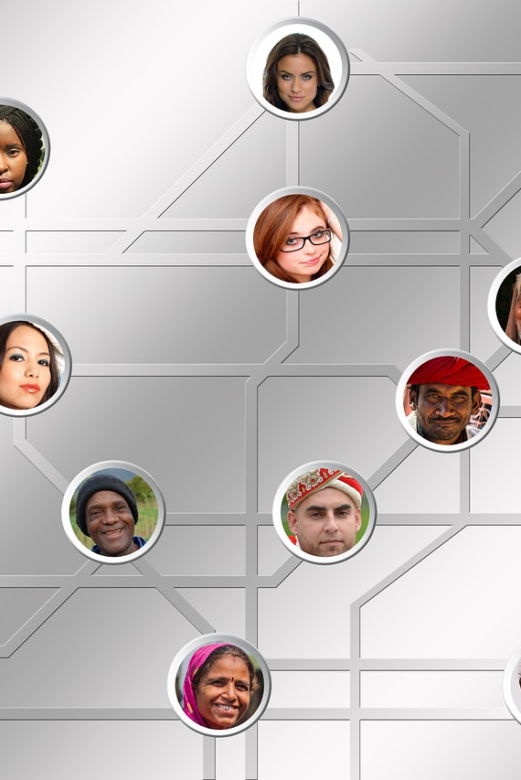
Basic Dialogue Flow Handling Greetings
Normal Query Handling
Designing Responses for Common Queries
Ensuring a UserFriendly Experience

Slide 16
Dataset Preprocessing
Enhancing Data for Better Performance
Converting Text to Lowercase
Utilizing RNN (Recurrent Neural Networks) for Processing
Transfer Learning and FineTuning

Slide 17
Model Approach
Introduction to RRN (Recurrent Neural Networks)
Combining RRN with LSDM for Enhanced Accuracy
Exploring Direct Use of GPT-2.0.

Slide 18
Choosing the Right Model
Define Objectives Clearly:
Align model choice with specific goals.
Clarity ensures optimal model selection.
Consider Data Characteristics:
Match model capabilities with data nature.
Enhances compatibility and performance.
Evaluate Model Complexity:
Balance complexity with available resources.
Optimize for efficiency and effectiveness.
Explore Pre-trained Models:
Leverage pre-trained models when suitable.
Reduces training time and resource requirements.
Scalability and Future Needs:
Choose a scalable model for growth and Account for potential future data variations.

Slide 19

Integrating Visuals with GPT-2
Customizing GPT-2 with Visual Information
Utilizing ResNet 50 for Image Processing
Enhancing User Interaction

Slide 20

Language Chain Framework
Implementing Language Chain Framework Seamless Integration for Multilingual Support Ensuring Consistent and Cohesive Conversations

Slide 21
Hosting Solutions: Efficient Hosting with Streamlit and Gradio
Overview of Streamlit and Gradio Libraries
UserFriendly Interfaces for Hosting
Enhancing Accessibility

Slide 22
Precautions and Future Enhancements
Frequently Asked Questions (FAQ)
Ensuring Chatbot Accuracy and Security
Maker Future Enhancements and Continuous Improvement
Handling Sensitive Questions and Data

Slide 23
References
[1] Batyrkhan Omarov, Zhandos Zhumanov, Aidana Gumar, Leilya Kuntunova “Artificial Intelligence Enabled Mobile Chatbot Psychologist using AIML and Cognitive Behavioral Therapy,” in 2023
[2] Vanshika Arya, Rukhsar Khan, Mukul Aggarwa “A Chatbot Application by using Natural Language Processing and Artificial Intelligence Markup Language” in 2022
[3] Minh-Tien Nguyen , Manh Tran-Tien , Anh Phan Viet , Huy-The Vu , and Van-Hau Nguyen “Building a Chatbot for Supporting the Admission of Universities” in 2021
[4] ANDREJ MIKLOSIK , NINA EVANS, ATHAR QURESHI “The Use of Chatbots in Digital Business Transformation: A Systematic Literature Review” in 2021
[5] E. Kasthuri, S. Balaji “Natural language processing and deep learning chatbot using long short term memory algorithm” in 2021

Slide 24
References
[6] SHAZIYA BANU, SHANTALA DEVI PATIL “An Intelligent Web App Chatbot” in 2020
[7] Ajinkya Huddar , Chaitanya Bysani , Chintan Suchak , Uttam D Kolekar , Kaushiki Upadhyaya “Dexter the College FAQ Chatbot” in 2020
[8] Sangeeta Kumari , Zaid Naikwadi, Akshay Akole, Purushottam Darshankar “Enhancing College Chat Bot Assistant with the Help of Richer Human Computer Interaction and Speech Recognition” in 2020
[9] Dharani M, Jyostna JVSL, Sucharitha E, Likitha R, “Interactive Transport Enquiry with AI Chatbot,” in 2020
[10] Nithuna S, Laseena C.A “Review on Implementation Techniques of Chatbot” in 2020.

Slide 25
References
[10] Nithuna S, Laseena C.A “Review on Implementation Techniques of Chatbot” in 2020.
[11] Bhriguraj Borah, Dhrubajyoti Pathak, Priyankoo Sarmah, Bidisha Som, Sukumar Nandi “Survey of Textbased Chatbot in Perspective of Recent Technologies” in 2019
[12] Malvika R, Vikram K Kharvi, Akhil Bidhuri, Bhaskar Kumar, Dr Annapurna D “Enterprise Chat Platform using Machine Learning Techniques” in 2019
[13] Rico Arisandy Wijaya, Entin Martiana Kusumaningtyas, Aliridho Barakbah “Knowledge Based CHATBOT With Context Recognition” in 2019
[14] V. Krishna sree, C. Kaushik, G. Sahitya, Remalli Rohan “Various Real Time Chat Bots and Their Applications in Human Life” in 2019
[15] Bhavika R. Ranoliya, Nidhi Raghuwanshi, Sanjay Singh “Chatbot for University Related FAQs” in 2019

Slide 26
Thank you for your time 😊

